Slide 1
Chapter 7
Reactions in Aqueous Solutions

Slide 2

Predicting Whether a Reaction Will Occur
Why does a chemical reaction occur?
As chemists have studied reactions, they have recognized several “tendencies” in reactants that drive them to form products.
  That is, there are several “driving forces” that pull reactants toward products—changes that tend to make reactions go in the direction of the arrow.

Slide 3
Driving Forces
The most common of these driving forces are
Formation of a solid
Formation of water
Transfer of electrons
Formation of a gas

Slide 4
Research Activity – Unit 7.1
Research chemical reactions and find a chemical reaction that corresponds to each of the following categories:
Formation of a solid
Formation of water
Transfer of electrons
Formation of a gas

Slide 5
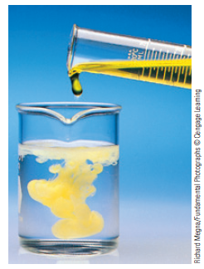
Precipitation Reactions
One driving force for a chemical reaction is the formation of a solid, a process called precipitation.
The solid that forms is called a precipitate, and the reaction is known as a precipitation reaction.

Slide 6
Ionic Compounds in Water
In virtually every case when a solid containing ions dissolves in water, the ions separate and move around independently.
  That is, Ba(NO₃)₂(aq) does not contain Ba(NO₃)₂ units.
  Rather, it contains separated Ba²⁺ and NO₃– ions.
  In the solution there are two NO₃– ions for every Ba²⁺ ion.

Slide 7
Strong Electrolytes
Chemists know that separated ions are present when a solution is an excellent conductor of electricity.
Pure water does not conduct an electric current.
Ions must be present in water for a current to flow.
When each unit of a substance that dissolves in water produces separated ions, the substance is called a strong electrolyte.

Slide 8
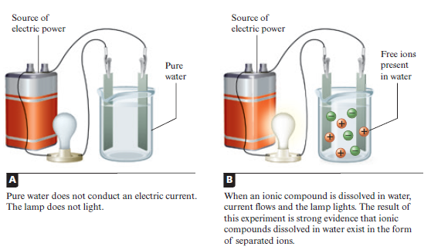
Electrolytes

Slide 9
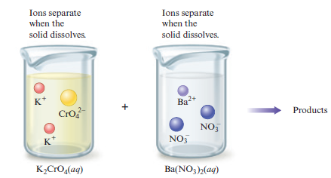

Mixing Electrolytes

Slide 10
How to Decide What Products Form
A solid compound must have a zero net charge.
  This means that the product of our reaction must contain both anions and cations (negative and positive ions).
  For example, K⁺ and Ba²⁺ could not combine to form the solid because such a solid would have a positive charge. Similarly, CrO₄^{2–} and NO₃– could not combine to form a solid because that solid would have a negative charge.
Most ionic materials contain only two types of ions—one type of cation and one type of anion.

Slide 11
Solubility Rules
Table 7.1 General Rules for Solubility of Ionic Compounds (Salts) in Water at 25 °C
Most nitrate (NO₃⁻) salts are soluble.
Most salts of Na⁺, K⁺, and NH₄⁺ are soluble.
Most chloride salts are soluble. Notable exceptions are AgCl, PbCl₂, and Hg₂Cl₂.
Most sulfate salts are soluble. Notable exceptions are BaSO₄, PbSO₄, and CaSO₄.
Most hydroxide compounds are only slightly soluble.* The important exceptions are NaOH and KOH. Ba(OH)₂ and Ca(OH)₂ are only moderately soluble.
Most sulfide (S²⁻), carbonate (CO₃²⁻), and phosphate (PO₄³⁻) salts are only slightly soluble.*
*The terms insoluble and slightly soluble really mean the same thing: such a tiny amount dissolves that it is not possible to detect it with the naked eye.

Slide 12
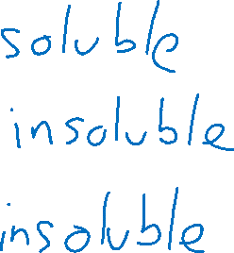
Solubility Practice
Classify the following compounds as either soluble or insoluble:
NaOH
BaSO₄
CaCO₃

Slide 13
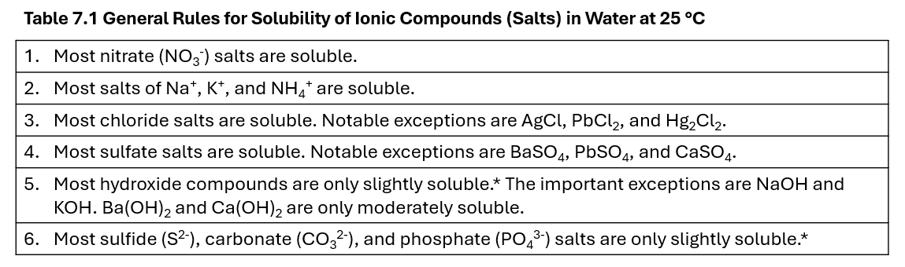
TopHat

Slide 14
How to Predict Precipitates When Solutions of Two Ionic Compounds Are Mixed
Write the reactants as they actually exist before any reaction occurs.
  Remember that when a salt dissolves, its ions separate.
Consider the various solids that could form.
  To do this, simply exchange the anions of the added salts.
Use the solubility rules (Table 7.1) to decide whether a solid forms and, if so, to predict the identity of the solid.

Slide 15
Molecular Equations
A molecular equation shows the complete formulas of all reactants and products.
  However, although this equation shows the reactants and products of the reaction, it does not give a very clear picture of what actually occurs in solution.

Slide 16

Complete Ionic Equations
A complete ionic equation better represents the actual forms of the reactants and products in solution.
  In a complete ionic equation, all substances that are strong electrolytes are represented as ions.

Slide 17
Net Ionic Equations
Ions which do not participate directly in a reaction in solution are called spectator ions.
Net ionic equations include only those components that are directly involved in the reaction.
  Chemists usually write the net ionic equation for a reaction in solution, because it gives the actual forms of the reactants and products and includes only the species that undergo a change.

Slide 18
Types of Equations for Reactions in Aqueous Solutions
Three types of equations are used to describe reactions in solutions.
The molecular equation shows the overall reaction but not necessarily the actual forms of the reactants and products in solution.
The complete ionic equation represents all reactants and products that are strong electrolytes as ions. All reactants and products are included.
The net ionic equation includes only those components that undergo a change. Spectator ions are not included.

Slide 19
Writing Equations Practice
Write the complete ionic and net ionic equation for the following reaction:
Pb(NO₃)₂(aq) + 2KI(aq) → PbI₂(s) + 2KNO₃(aq)

Slide 20
Practice
Write the molecular, complete ionic, and net ionic equation for the reaction of a solution of sodium chloride being added to a solution of silver nitrate.

Slide 21
Arrhenius Acids
Svante Arrhenius proposed that an acid is a substance that produces H⁺ ions (protons) when it is dissolved in water.
Studies show that when HCl, HNO₃, and H₂SO₄ are placed in water, virtually every molecule dissociates to give ions.
Because these substances are strong electrolytes that produce H⁺ ions, they are called strong acids.

Slide 22
Arrhenius Bases
Arrhenius also found that aqueous solutions that exhibit basic behavior always contain hydroxide ions.
He defined a base as a substance that produces hydroxide ions (OH–) in water.
Hydroxide compounds that are strong electrolytes are called strong bases.

Slide 23

Acid-Base Reactions
There are two important things to note as we examine the reaction of hydrochloric acid with aqueous sodium hydroxide and the reaction of nitric acid with aqueous potassium hydroxide.
The net ionic equation is the same in both cases; water is formed.
Besides water, which is always a product of the reaction of an acid with OH–, the second product is an ionic compound (called a salt), which might precipitate or remain dissolved, depending on its solubility.

Slide 24
Summary of Strong Acids and Strong Bases – Principles 1-2
The following points about strong acids and strong bases are particularly important.
The common strong acids are aqueous solutions of HCl, HNO₃, and H₂SO₄.
A strong acid is a substance that completely dissociates (ionizes) in water. (Each molecule breaks up into an H⁺ ion plus an anion.)

Slide 25
Summary of Strong Acids and Strong Bases – Principles 3-4
The following points about strong acids and strong bases are particularly important.
A strong base is a metal hydroxide compound that is very soluble in water. The most common strong bases are NaOH and KOH, which completely break up into separated ions (Na⁺ and OH– or K⁺ and OH–) when they are dissolved in water.
The net ionic equation for the reaction of a strong acid and a strong base (contains OH–) is always the same: it shows the production of water.

Slide 26
Summary of Strong Acids and Strong Bases – Principles 5-6
The following points about strong acids and strong bases are particularly important.
In the reaction of a strong acid and a strong base, one product is always water, and the other is always an ionic compound called a salt, which remains dissolved in the water. This salt can be obtained as a solid by evaporating the water.
The reaction of H⁺ and OH– is often called an acid–base reaction, where H⁺ is the acidic ion and OH– is the basic ion.

Slide 27
Practice
Balance the reaction, write the complete and net ionic equations.
  H₃PO₄ + Ca(OH)₂ -> Ca₃(PO₄)₂ + H₂O

Slide 28
Write the molecular reaction of nitrous acid and potassium hydroxide and balance it. Show the complete and net ionic equations.

Slide 29
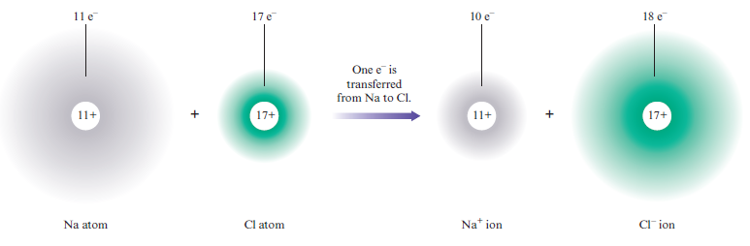
Transferring Electrons
When a sodium atom reacts with a chlorine atom an electron is transferred.

Slide 30
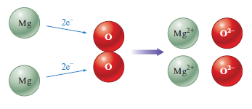
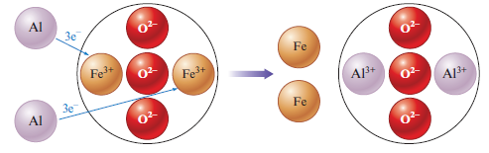
Electron Transfer in Reactions
A reaction that involves a transfer of electrons is called an oxidation–reduction reaction.

Slide 31
Characteristics of Oxidation–Reduction Reactions – Principle 1
When a metal reacts with a nonmetal, an ionic compound is formed.
  The ions are formed when the metal transfers one or more electrons to the nonmetal, the metal atom becoming a cation and the nonmetal atom becoming an anion.
  Therefore, a metal–nonmetal reaction can always be assumed to be an oxidation–reduction reaction, which involves electron transfer.

Slide 32
Characteristics of Oxidation–Reduction Reactions – Principle 2
Two nonmetals can also undergo an oxidation–reduction reaction.
  At this point we can recognize these cases only by looking for O₂ as a reactant or product.
  When two nonmetals react, the compound formed is not ionic.

Slide 33
Oxidation–Reduction Reactions Practice
Is the following an oxidation–reduction reaction? If so, how many electrons are transferred from each Al atom?
2Al + N₂ → 2AlN

Slide 34
Practice
Solid copper reacts with aqueous iron(II) chloride to form solid iron and aqueous copper(II) chloride.
Write the molecular equation, balance it, and determine how many electrons are lost or gained by the various species.

Slide 35

Precipitation Reaction
In this reaction solid BaCrO₄ (a precipitate) is formed.
Because the formation of a solid when two solutions are mixed is called precipitation, we call this a precipitation reaction.

Slide 36
Double-Displacement Reactions
Notice in this reaction that two anions (NO₃– and CrO₄^{2–}) are simply exchanged.
Note that CrO₄^{2–} was originally associated with K⁺ in K₂CrO₄ and that NO₃– was associated with Ba²⁺ in Ba(NO₃)₂.
In the products these associations are reversed.
Because of this double exchange, we sometimes call this reaction a double-exchange reaction or double-displacement reaction.

Slide 37
Acid–Base Reactions
We classify this reaction as an acid–base reaction.
You can recognize this as an acid–base reaction because it involves an H⁺ ion that ends up in the product water.

Slide 38
Oxidation–Reduction Reactions
In this reaction each lithium atom loses one electron to form Li⁺, and each fluorine atom gains one electron to form the F– ion.
The process of electron transfer is also called oxidation–reduction.
Thus, we classify the preceding reaction as an oxidation–reduction reaction.

Slide 39
Gas Evolution Reactions
In this reaction carbon dioxide gas is formed.
This reaction is also an acid–base reaction.

Slide 40

Single-Replacement Reactions
This reaction is an oxidation–reduction reaction.
This reaction is also a single-replacement reaction since a single type of anion (Cl–) was exchanged between H⁺ and Zn²⁺.

Slide 41
Combustion Reactions
Many chemical reactions that involve oxygen produce energy (heat) so rapidly that a flame results.
Such reactions are called combustion reactions.

Slide 42
Synthesis (Combination) Reactions
When a given compound is formed from simpler materials, we call this a synthesis (or combination) reaction.

Slide 43
Decomposition Reactions
In many cases a compound can be broken down into simpler compounds or all the way to the component elements.
  This is usually accomplished by heating or by the application of an electric current.
Such reactions are called decomposition reactions.

Slide 44
Reaction Classification Practice
Classify the following as combustion, synthesis, or decomposition reactions:
N₂ + 3H₂ → 2NH₃
C₆H₁₂O₆ + 6O₂ → 6CO₂ + 6H₂O
2H₂O → 2H₂ + O₂

Slide 45
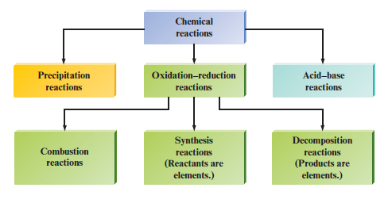
Summary of Classes of Reactions

